Slide 1
Implementation of counter using Timer:
Engr. Shahzada Fahim Jan

Slide 2
Timer can also be used as counters counting events happening out-side the 8051.
When we use timer as counter it is a pulse outside the 8051 that increments the TH, TL registers.
When C/T=1, the timer is used as a counter and gets its pulse from outside the 8051.
The pulses are fed from pins 14 (T0) and 15(T1).

Slide 3
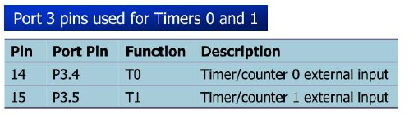

Slide 4
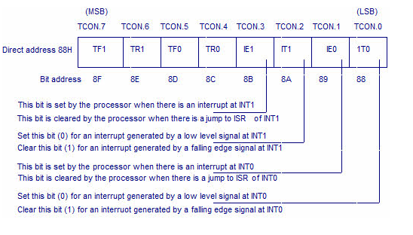

Slide 5
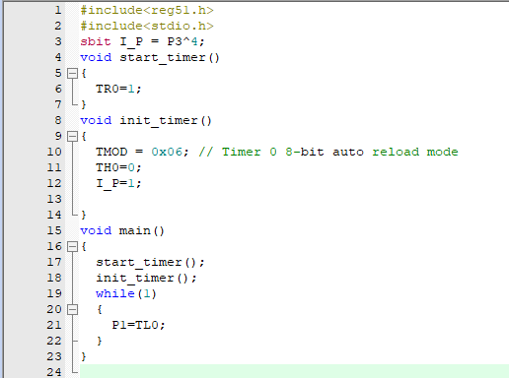

Slide 6
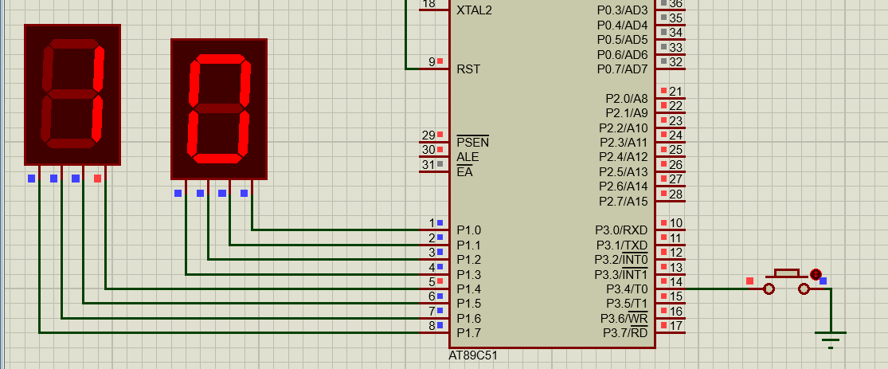

Slide 7
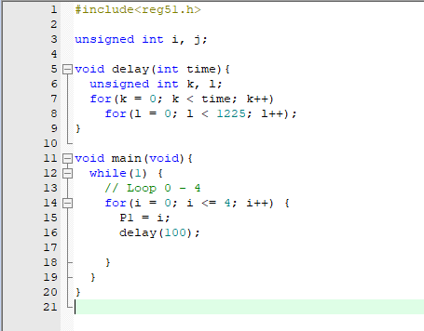

Slide 8
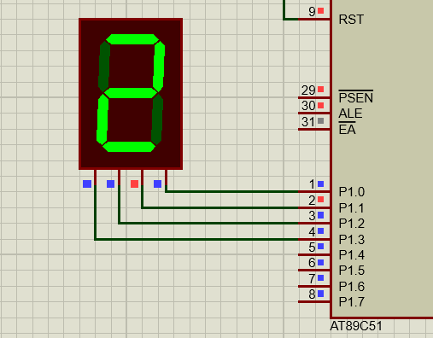

Slide 9
TASKS:
1) Implement Counter using Timer that take pulses from P3^4
2) Implement Counter that counts from 0 to 9.
3) Implement Counter that counts from 00 to 99

